Slide 1
FSM and Efficient Synthesizable FSM Design using Verilog
S. Rawat

Slide 2
Introduction
There are many ways to code FSMs including many very poor ways to code FSMs.
This lecture offers guidelines for doing efficient coding, simulation and synthesis of FSM designs.
In this lecture multiple references are made to combinational always blocks and sequential always blocks.

Slide 3
Introduction
Combinational always blocks are always blocks that are used to code combinational logic functionality and are strictly coded using blocking assignments. A combinational always block has a combinational sensitivity list, a sensitivity list without "posedge" or "negedge" Verilog keywords.
Sequential always blocks are always blocks that are used to code clocked or sequential logic and are always coded using nonblocking assignments. A sequential always block has an edge-based sensitivy list.

Slide 4
Mealy & Moore FSMs
A common classification used to describe the type of an FSM is Mealy and Moore state machines.
A Moore FSM is a state machine where the outputs are only a function of the present state.
A Mealy FSM is a state machine where one or more of the outputs is a function of the present state and one or more of the inputs.

Slide 5
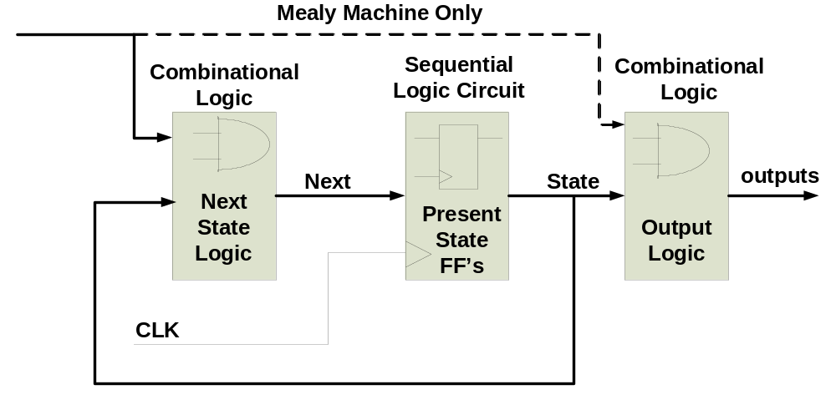
Mealy & Moore FSMs (contd.)

Slide 6
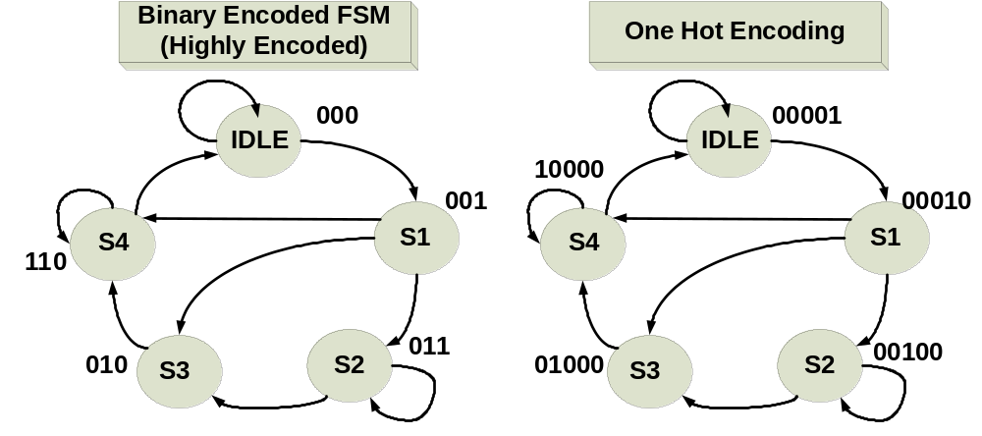
Binary Encoded or One Hot Encoding

Slide 7
Binary Encoded or One Hot Encoding
A binary-encoded FSM design only requires as many flip-flops as are needed to uniquely encode the number of states in the state machine.
Number of FF
if(log2(#states) == integer)
required FF = log2(#states)
else
required FF = integer(log2(#states))+1;

Slide 8
Binary Encoded or One Hot Encoding
A onehot FSM design requires a flip-flop for each state in the design and only one flip-flop (the flip-flop representing the current or "hot" state) is set at a time in a onehot FSM design.
For a state machine with 9-16 states, a binary FSM only requires 4 flip-flops while a onehot FSM requires a flip-flop for each state in the design (9-16 flip-flops).

Slide 9
FSM Coding Goals
What constitutes an efficient FSM coding style?
Identify HDL coding goals and why they are important.
Quantify the capabilities of various FSM coding styles.

Slide 10
FSM Coding Goals
The FSM coding style should be easily modified to change state encodings and FSM styles.
The coding style should be compact.
The coding style should be easy to code and understand.
The coding style should facilitate debugging.
The coding style should yield efficient synthesis results.

Slide 11
Two Always Block FSM Style (Good Style)
One of the best Verilog coding styles is to code the FSM design using two always blocks, one for the sequential state register and one for the combinational next-state and combinational output logic.

Slide 12
module fsm_4states
(output reg gnt,
input dly, done, req, clk, rst_n);
parameter [1:0] IDLE = 2'b00,
BBUSY = 2'b01,
BWAIT = 2'b10,
BFREE = 2'b11;
reg [1:0] state, next;
always @(posedge clk or negedge rst_n)
if (!rst_n) state <= IDLE;
else state <= next;
Two Always Block FSM Style (Good Style)

Slide 13
always @(state or dly or done or req) begin
next = 2'bx;
gnt = 1'b0;
case (state)
IDLE : if (req) next = BBUSY;
else next = IDLE;
BBUSY: begin
gnt = 1'b1;
if (!done) next = BBUSY;
else if ( dly) next = BWAIT;
else next = BFREE;
end
BWAIT: begin
gnt = 1'b1;
if (!dly) next = BFREE;
else next = BWAIT;
end
BFREE: if (req) next = BBUSY;
else next = IDLE;
endcase end endmodule
Two Always Block FSM Style (Good Style)

Slide 14
Making default next equal all X's assignment
Placing a default next state assignment on the line immediately following the always block sensitivity list is a very efficient coding style. This default assignment is updated by next-state assignments inside the case statement.
There are three types of default next-state assignments that are commonly used: (1) next is set to all X's, (2) next is set to a predetermined recovery state such as IDLE, or (3) next is just set to the value of the state register.
By making a default next state assignment of X's, pre-synthesis simulation models will cause the state machine outputs to go unknown if not all state transitions have been explicitly assigned in the case statement.
This is a useful technique to debug state machine designs, plus the X's will be treated as "don't cares" by the synthesis tool.
Some designs require an assignment to a known state as opposed to assigning X's. Examples include: satellite applications, medical applications, designs that use the FSM flip-flops as part of a diagnostic scan

Slide 15
One Always Block FSM Style (Avoid This Style!)
One of the most common FSM coding styles in use today is the one sequential always block FSM coding style.
For most FSM designs, the one always block FSM coding style is more verbose, more confusing and more error prone than a comparable two always block coding style.

Slide 16
One Always Block FSM Style:
module fsm_4states
(output reg gnt,
input dly, done, req, clk, rst_n);
parameter [1:0] IDLE = 2'd0,
BBUSY = 2'd1,
BWAIT = 2'd2,
BFREE = 2'd3;
reg [1:0] state;

Slide 17
One Always Block FSM Style:
always @(posedge clk or negedge rst_n)
if (!rst_n) begin
state <= IDLE;
gnt <= 1'b0;
end
else begin
state <= 2'bx;
gnt <= 1'b0;
case (state)
IDLE : if (req) begin
state <= BBUSY;
gnt <= 1'b1;
end
else

Slide 18
One Always Block FSM Style
BBUSY: if (!done) begin
state <= BBUSY;
gnt <= 1'b1;
end
else if ( dly) begin
state <= BWAIT;
gnt <= 1'b1;
end
else state <= BFREE;
BWAIT: if ( dly) begin
state <= BWAIT;
gnt <= 1'b1;
end
else state <= BFREE;
BFREE: if (req) begin
state <= BBUSY;
gnt <= 1'b1;
end
else state <= IDLE;
endcase
end
endmodule

